Slide 1


Team 36: Mesh Walkie Talkies
Bi-Weekly Update 3 Cole Cieslewicz, Jaiah Steele, Junsu Yeo Sponsor: Giuseppe Rizzi TA: Niloofar Borzooei
Notes:
Michelle

Slide 2
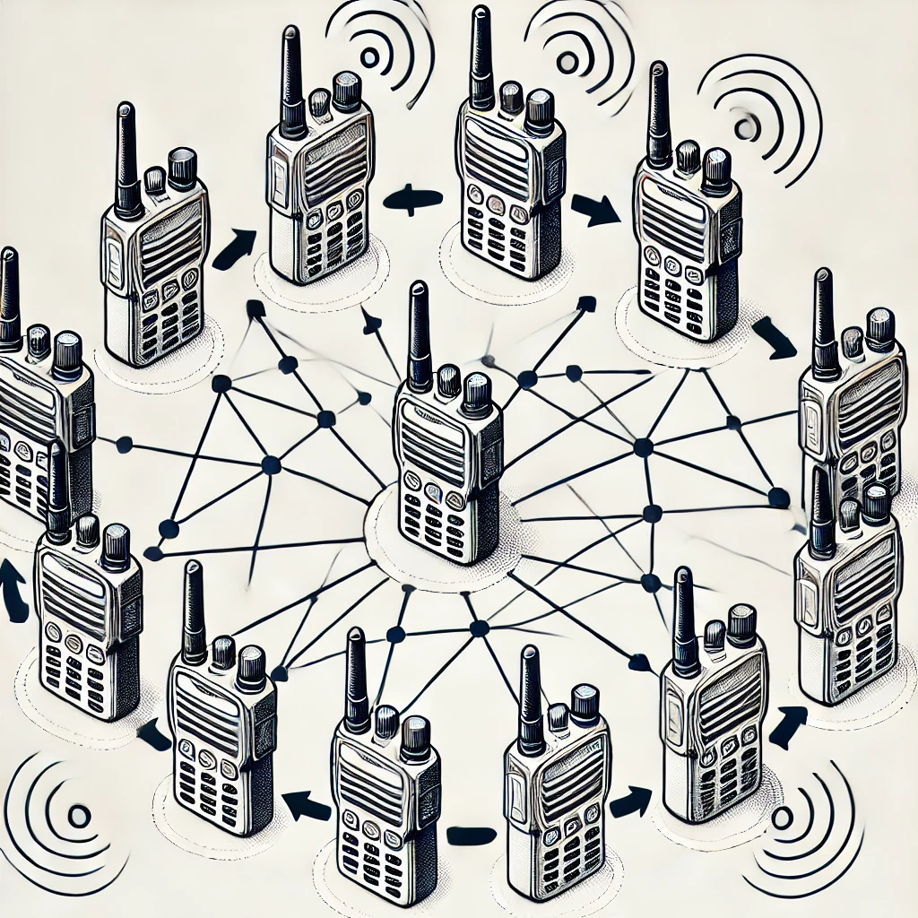
Project Summary
Conventional Walkie-Talkies:
Require close, limited communication
No network advantage
Our solution:
Mesh network to extend communication range and reliability.
Notes:
Kyle

Slide 3
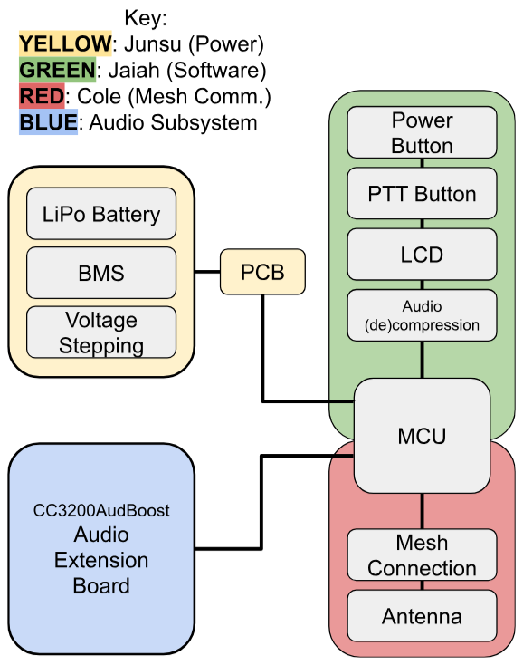
Project/Subsystem Overview
Notes:
Eric

Slide 4
Project Timeline
Subsystem Designs and Testing (completed 1/31) | Integration of Power System and Launchpad (to complete by 2/26) | Integration of mesh network and audio (to complete by 3/5) | 3D printing walkie talkie case (to complete by 3/12) | Enclosing device and System Test (to complete by 4/02) | Validation (to complete by 4/16) | Demo and Report (to complete by 4/28)
Key:
Green = Completed
Yellow = In Progress
White = Have not started
Notes:
Eric

Slide 5
Push-To-Talk/RF Subsystem Jaiah Steele
Accomplishments since last update 15 hrs of effort | Ongoing progress/problems and plans until the next presentation
Spent 15 hours working on integrating TX and RX functionality into a unified firmware, but full integration is still in progress. Identified issues with LCD updates and packet synchronization, which are causing delays in properly displaying transmission status. Fixing inconsistencies in switching between transmitting and receiving modes. | Complete integration of TX/RX system to allow seamless communication between LaunchPads. Fix LCD status update issues so that transmission and reception states are clearly displayed. Perform functional testing of integrated communication, ensuring packets are transmitted, received, and acknowledged correctly.

Slide 6
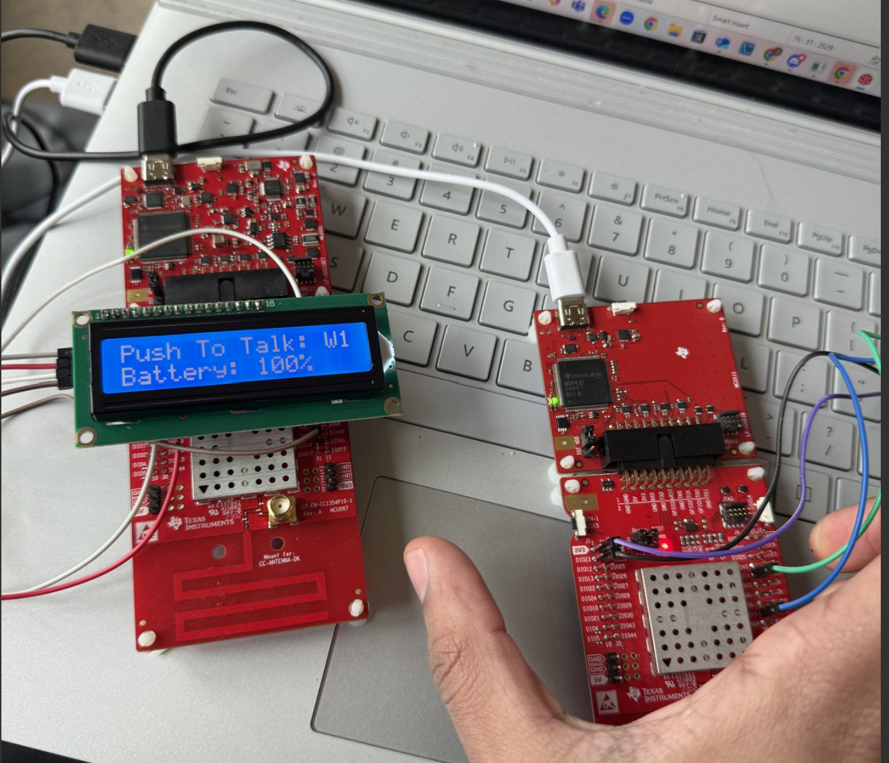
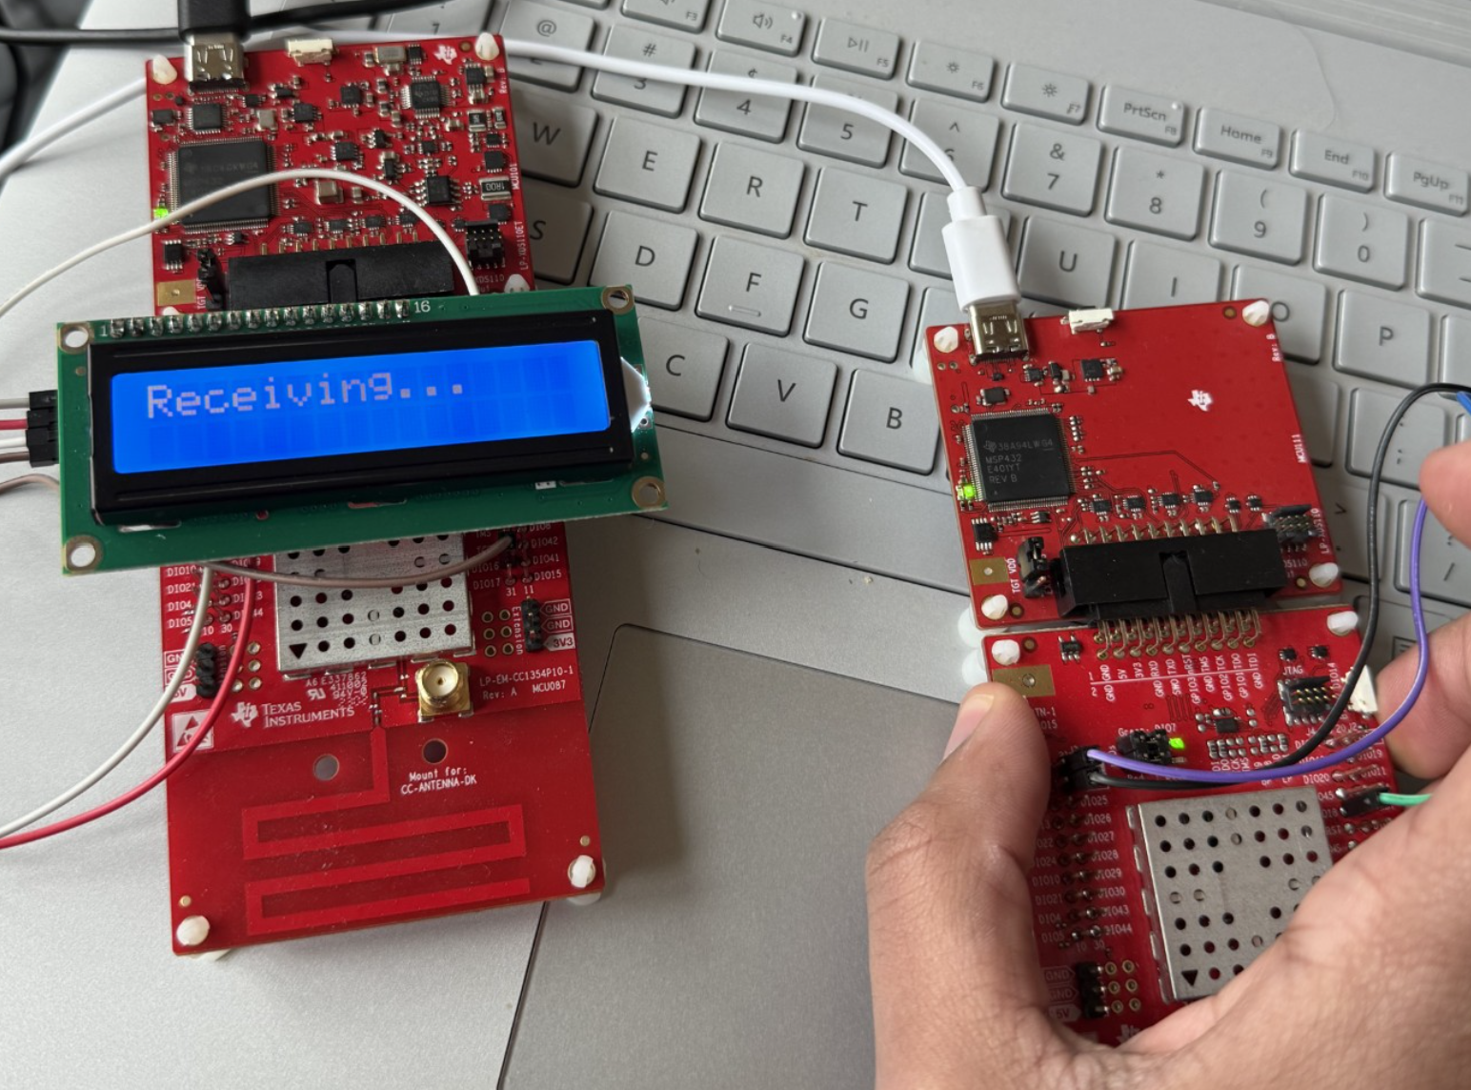
Push-To-Talk/RF Subsystem - Jaiah
How it works: RF @ 868 MHz
Transmits packets when a button is pressed.
Listens for packets when idle.
Receives and immediately forwards packets to simulate mesh communication using an echo function (more hops, increased latency, negligible at small distances).
Each packet is 30 bytes long and includes:
2-byte sequence number (increments with each packet).
28 bytes of random payload data
For the future: Store 28 bytes of compressed audio in each packet/stream.

Slide 7
Mesh Connection Subsystem
Cole Cieslewicz
Accomplishments since last update 15 hrs of effort | Ongoing progress/problems and plans until the next presentation
Continued working to integrate audio functionality with my transmission code. Downloaded a variety of software codecs to attempt implementation. Removed UART functionality. | Software codecs implemented in code to get error-less code. Integrating with Jaiah’s audio/LCD system. Testing audio transmission. Testing mesh functionality with new PCB.

Slide 8
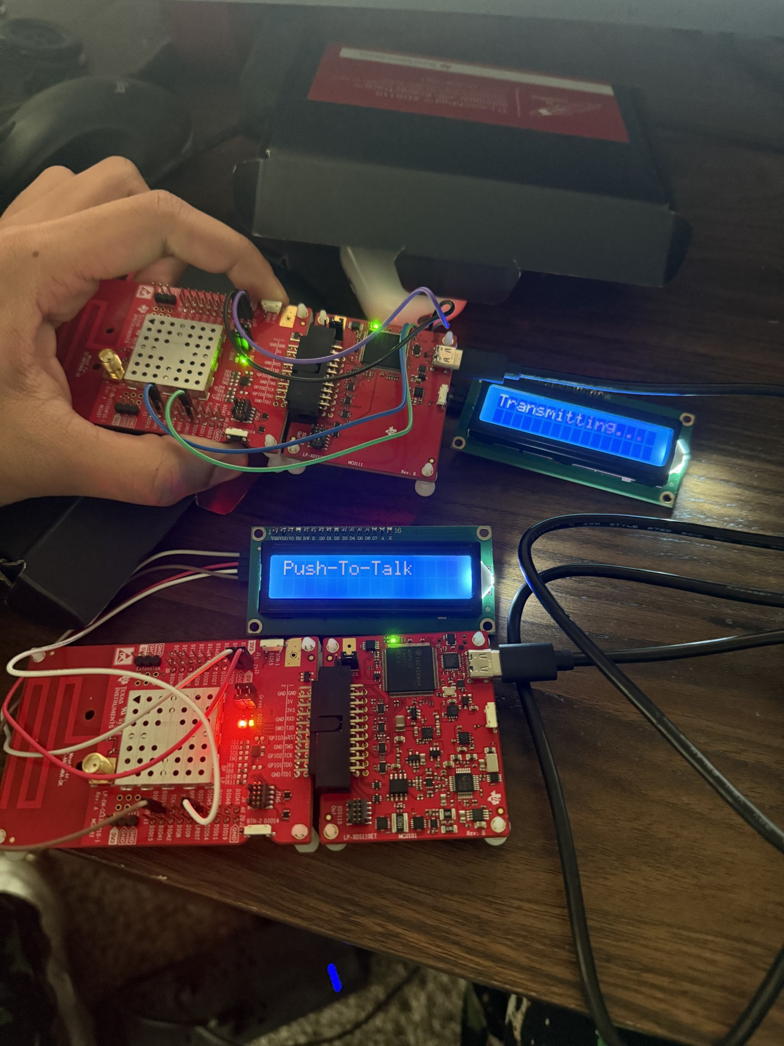
Mesh Connection Functionality
Cole Cieslewicz
Software Codecs Being Implemented
ADPCM, Speex, TI Hardware Codec, U-Law
Implementation with CC3200 is challenging, but necessary, and so far has had limited success
Audio not able to be tested with mesh combined until this is figured out

Slide 9
Power System
Junsu Yeo
Accomplishments since last update 10 hrs of effort | Ongoing progress/problems and plans until the next presentation
Final PCB & Components arrived. Assembly of power components. The PCB successfully powers all components. Audio(AudBoost, Mic, Speaker) LCD Display Launchpad Completed battery life test (24hrs). | Finish assembly of board (battery charger & protection). Start looking into solidworks or fusion360 or inventor to design the outer case of the walkie talkie. Work on the case design.

Slide 10
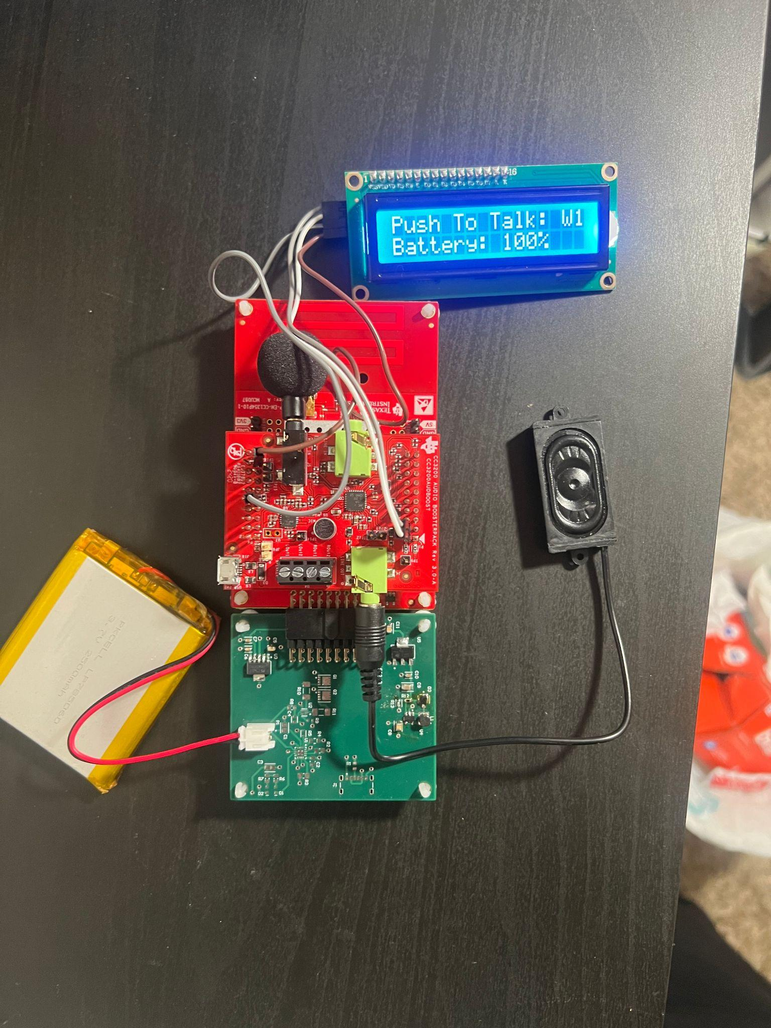
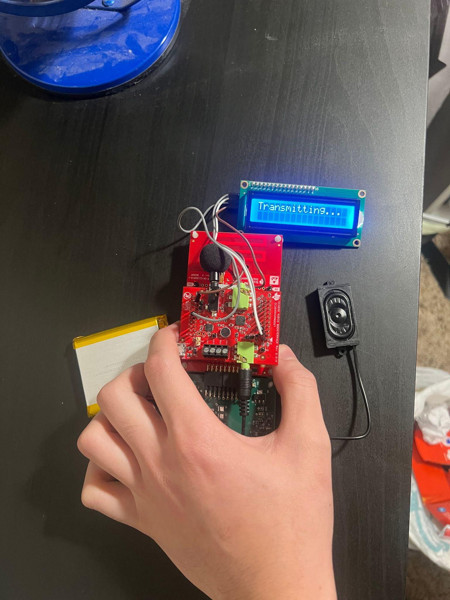
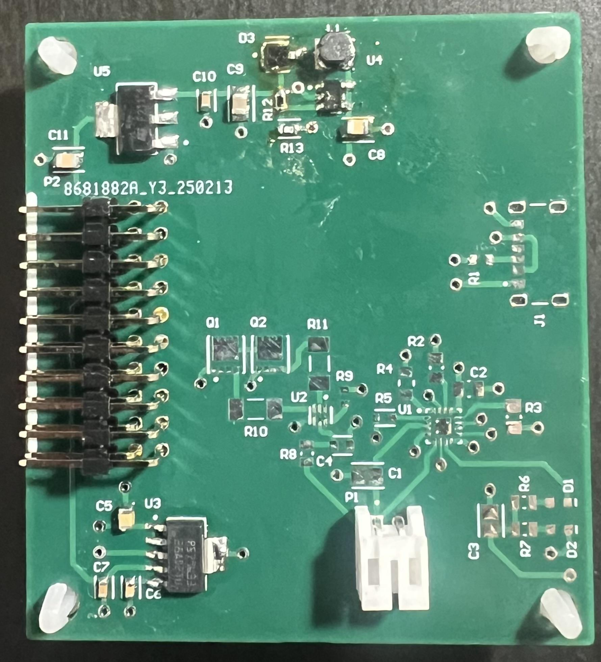
Power System
Junsu Yeo

Slide 11
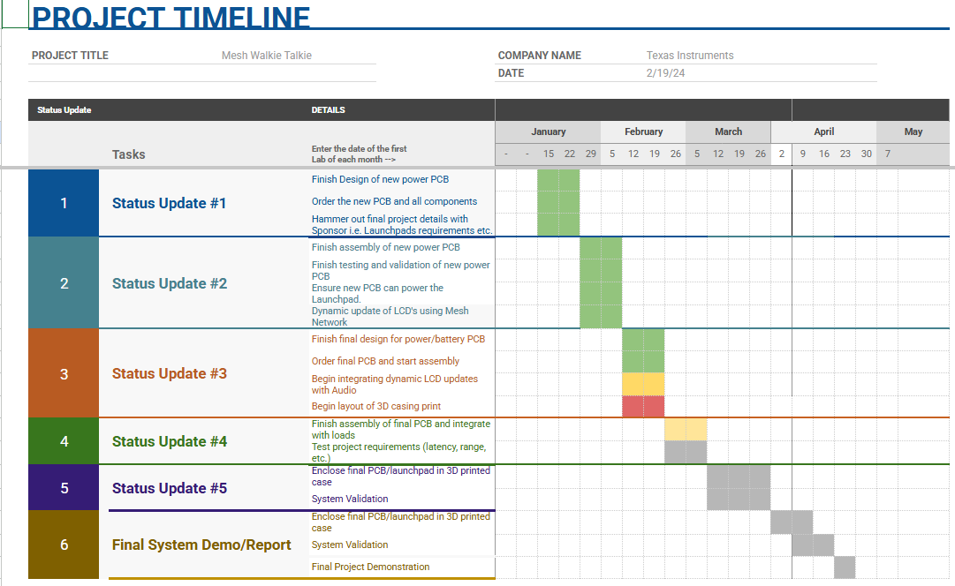
Execution Plan
Notes:
Michelle

Slide 12
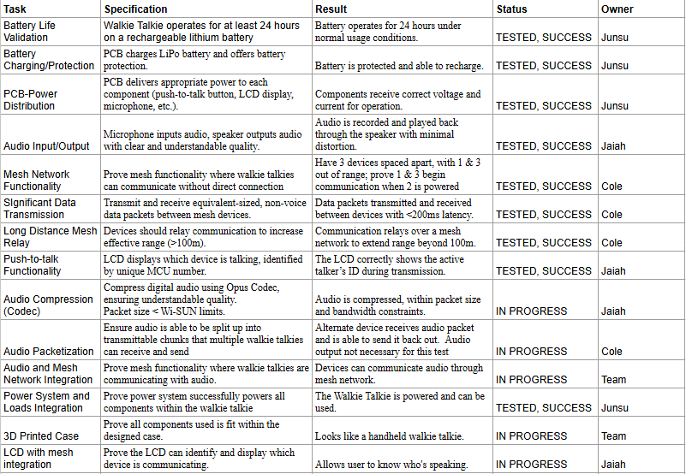
Validation Table

Slide 13
Thank you!

